Slide 1
Shopify App Store
ISTM 6212 Group 8
Jing Hui, Kai Ling, Elianna Wang, Xiang Fan

Slide 2
Final Project
Introduction
Part 1: Dataset
Part 2: Wrangling the data
Part 3: Data analysis

Slide 3
Introduction
Select dataset
Discuss and design dimension modeling
Shopify的APP和业务模式介绍

Slide 4
Dataset
shopify app store dataset
7 CSV file, total 75MB
about shopify app store apps (created by developers) and reviews (published by shops)
reflects how online shop owners interact with apps and what features they need.

Slide 5
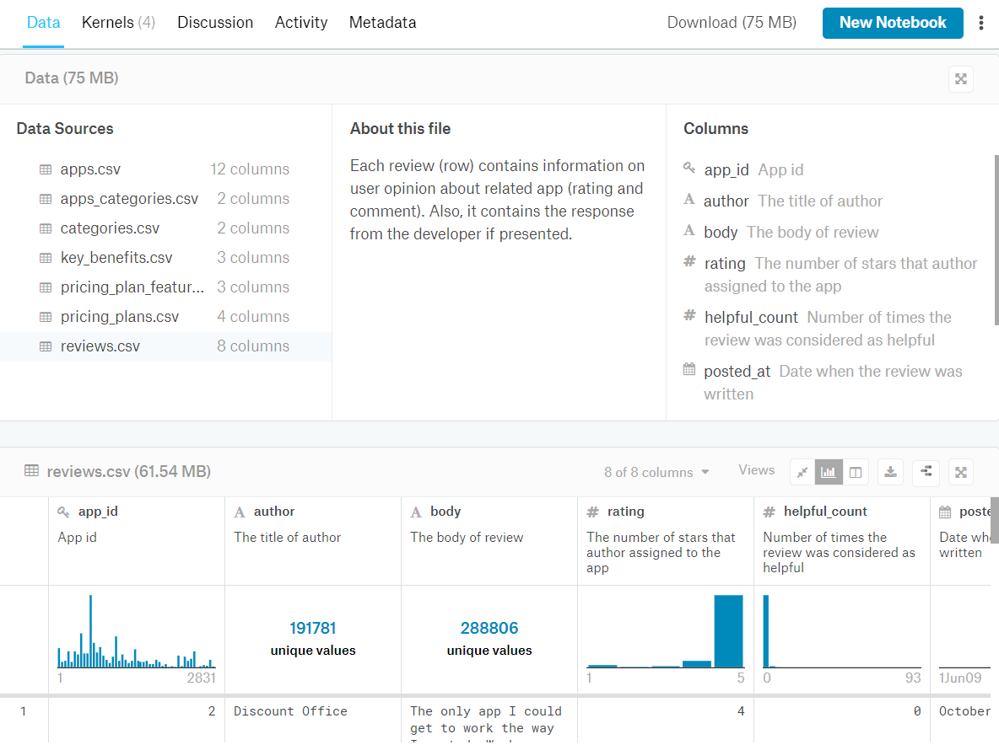
Dataset

Slide 6
Dataset
Can be used in multiple ways:
From monitoring of the customer satisfaction index of existing apps to niche analysis before starting a new app
In addition to the rating fact we care about, the time of rating posted, the app nature and price plan could be the dimensions of our interest

Slide 7
Analytics questions:
Find the top 10 apps with most rating records
Invastigate the relationship between review count and rating level
The relationship between time and rating
The relationship between price plan and rating

Slide 8
Expectation
Wrangling the data
Documenting the dimension modeling
Exploring the valuable information
Notes:
investigate the factors which have impact on rating.

Slide 9
Concerns
Missing rows on Trifacta
Columns currently unable to make use of: words, say customers’ reviews
Files are separated and it would be difficult to figure out the linkage files and potential missing linkage

Slide 10
Wrangling
using trifacta

Slide 11
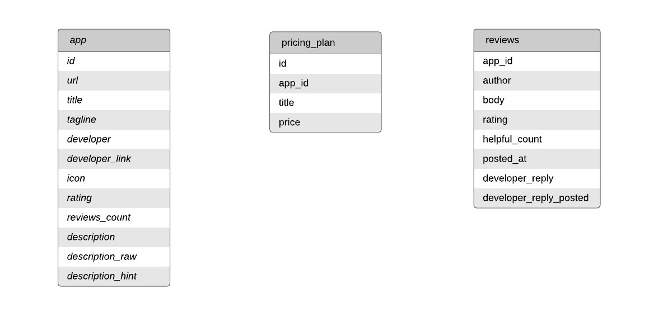
Raw dataset

Slide 12
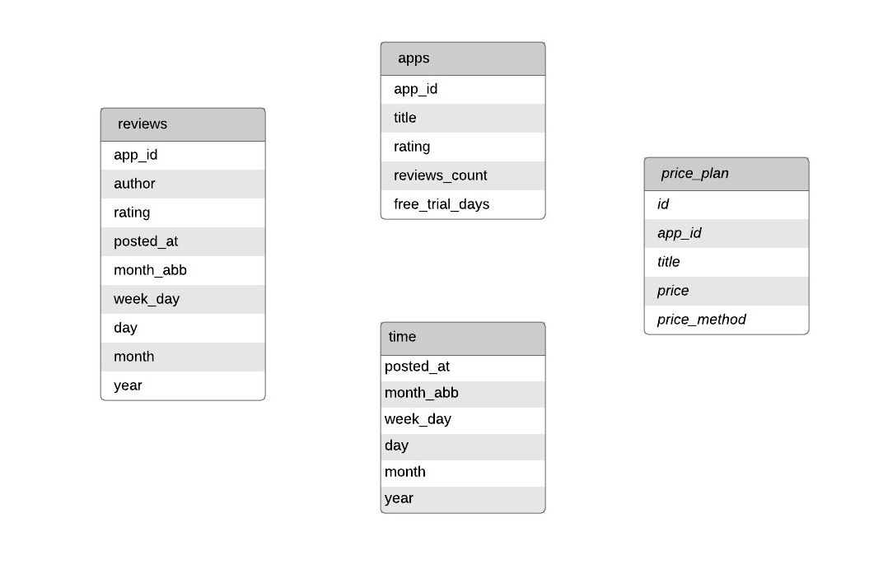
Wrangled dataset

Slide 13
Raw VS Wrangle
谁跟谁合并了，
谁又被拆分了

Slide 14
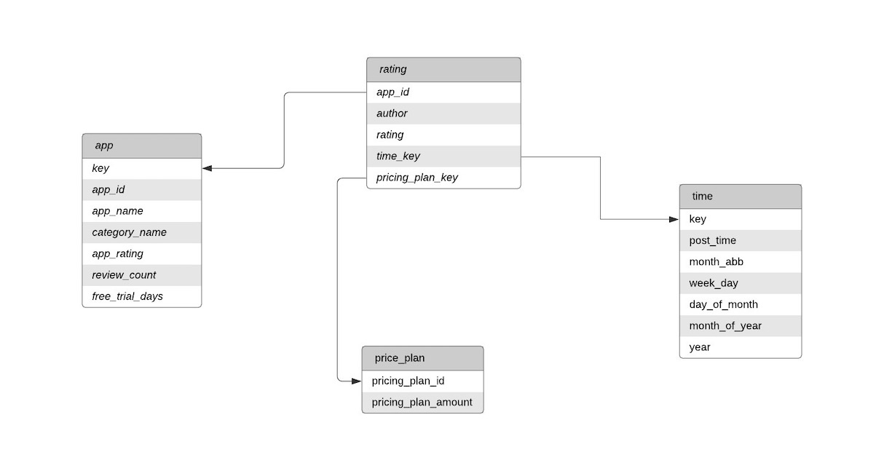
Dimensional table

Slide 15
Wrangling
1.create app dimensional table for analysis
merge the apps.csv and categories.csv based on apps_categories.csv to create the app dimensional table.
id | url | title | tagline | developer | developer_link | icon | rating | reviews_count | description | description_raw | pricing_hint
id | title
app_id | title | rating | reviews_count | free_trial_days

Slide 16
Wrangling
App dimension table
key | app_id | app_name | category_name | app_rating | review_count | free_trial_days
1 | 1 | HitCounter | Sales and conversion optimization | 4.4 | 39 | 0
2 | 1 | HitCounter | Store design | 4.4 | 39 | 0
3 | 2 | CategoriesUncomplicated | Store design | 5 | 34 | 10
4 | 3 | AdsbyVarinode | Marketing | 4.9 | 3336 | 0
5 | 4 | AllinOneMetafields | Productivity | 4.9 | 11 | 7

Slide 17
Wrangling
Create pricing plan dimensional table
pricing_plan_id | pricing_plan_amount
1 | 1
2 | 2
3 | 3
4 | 4

Slide 18
Wrangling
Create time dimension table
key | post_time | month_abb | week_day | day_of_month | month_of_year | year
1 | 17-Aug-14 | Aug | 7 | 17 | 8 | 2014
2 | 26-Feb-15 | Feb | 4 | 26 | 2 | 2015
3 | 1-Dec-16 | Dec | 4 | 1 | 12 | 2016
4 | 24-Feb-13 | Feb | 7 | 24 | 2 | 2013
5 | 28-Sep-16 | Sep | 3 | 28 | 9 | 2016
6 | 20-Oct-13 | Oct | 7 | 20 | 10 | 2013
7 | 26-May-18 | May | 6 | 26 | 5 | 2018
8 | 5-Jan-18 | Jan | 5 | 5 | 1 | 2018
9 | 6-May-13 | May | 1 | 6 | 5 | 2013
10 | 8-Nov-16 | Nov | 2 | 8 | 11 | 2016

Slide 19
Wrangling
Create the facts(rating) table
key | app_id | app_name | category_name | app_rating | review_count | free_trial_days
1 | 1 | HitCounter | Sales and conversion optimization | 4.4 | 39 | 0
2 | 1 | HitCounter | Store design | 4.4 | 39 | 0
3 | 2 | CategoriesUncomplicated | Store design | 5 | 34 | 10
4 | 3 | AdsbyVarinode | Marketing | 4.9 | 3336 | 0
5 | 4 | AllinOneMetafields | Productivity | 4.9 | 11 | 7

Slide 20
Data Analysis Q1
Find the 10 apps with most rating records？
%%sql
SELECT DISTINCT rating.app_id AS appid, app.app_name AS name, COUNT(rating.rating) AS count
FROM rating JOIN app
ON rating.app_id = app.app_id
GROUP BY appid, name
ORDER BY count DESC
LIMIT 10;

Slide 21
Data Analysis Q1
Output
1072 | EUCookieBar‑CookieGDPR | 4534
2457 | SalesPop‑SalesNotification | 4105
2313 | QuickAnnouncementBar | 3862
652 | UltimateSalesBoost | 3773
3 | AdsbyVarinode | 3336
448 | SmileRewards&Loyalty | 3241
appid | name | count
595 | Privy‑ExitPopUps&Email | 20517
570 | FreeShippingBarbyHextom | 8220
780 | RecartFBMessengerMarketing | 5553
427 | BESTCurrencyConverter | 5119

Slide 22
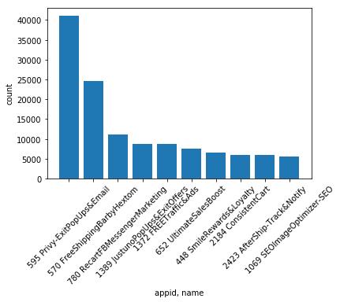
Data Analysis Q1

Slide 23
Data Analysis Q2
Investigate the relationship between review count and rating level.

Slide 24
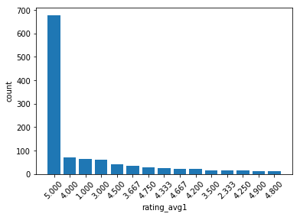
Data Analysis Q2
show from the largest count number and show the graph
rating avg | 5.00 | 4.00 | 1.00 | 3.00 | 4.50 | 3.67 | 4.75 | 4.33 | ...
count | 676 | 70 | 64 | 61 | 40 | 36 | 28 | 25 | ...

Slide 25
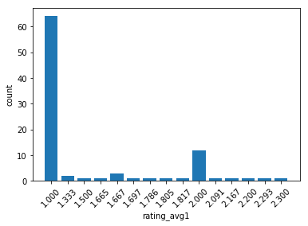
Data Analysis Q2
show from the smallest count number and show the graph
rating avg | 1.00 | 1.33 | 1.50 | 1.67 | 1.68 | 1.79 | 1.81 | 2.00 | ...
count | 64 | 2 | 1 | 4 | 1 | 1 | 1 | 12 | ...

Slide 26
Data Analysis Q2
Investigate the relationship between review count and rating level.
Count the review count of the same app_id and average the rating according to app_id. We can see that rating 5 star and rating 1 star has the highest review counts which means customers who appreciate specific apps and customers who complain about specific apps are willing to post their using experience.

Slide 27
Data Analysis Q3
The relationship between time and rating
SELECT DISTINCT time.week_day, COUNT(rating.rating)
FROM time JOIN rating
ON time.key = rating.time_key
GROUP BY time.week_day
ORDER BY count

Slide 28
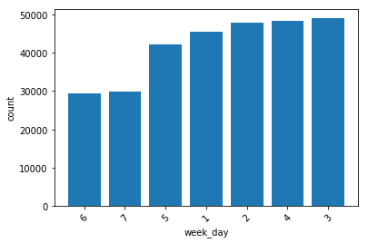
Data Analysis Q3
We found on weekends (Saturday and Sunday) customers are not willing to leave comments comparing to on weekdays.

Slide 29
Data Analysis Q4
The relationship between price plan and rating
%%sql
SELECT count(price_plan_key),price_plan_key
FROM rating
group by price_plan_key

Slide 30
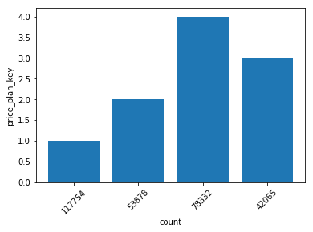
Data Analysis Q4
From rating table we can see price_plan 1 has the most comments
count | price_plan_key
117754 | 1
53878 | 2
78332 | 4
42065 | 3

Slide 31
Q4 Code
%%sql
SELECT count(price_plan_key),rating
FROM rating
where price_plan_key=1
group by rating
order by rating

Slide 32
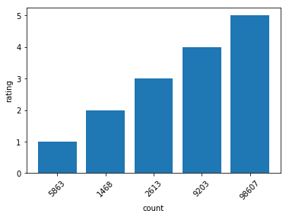
Data Analysis Q4
We can see that plan 1 has a large amount of 5 star evaluation so this plan is the most widely used plan as well as most successful plan.
count | rating
5863 | 1
1468 | 2
2613 | 3
9203 | 4
98607 | 5

Slide 33
--The End--
Thank you

